Slide 1

WAY TO ENTERPRISE
Pakage 1: Database

Slide 2
WAY TO ENTERPRISE
Lesson 6

Slide 3
Agenda
Stored Procedure
Function
Optional JOIN
Assignments
Copyright © VTI Academy All Rights Reserved

Slide 4
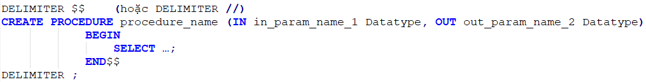
STORED PROCEDURE
Create
Call
Drop

Slide 5
Syntax
DELIMITER $$ Meaning
Parameter IN, OUT
The difference between Parameter and Variable

Slide 6
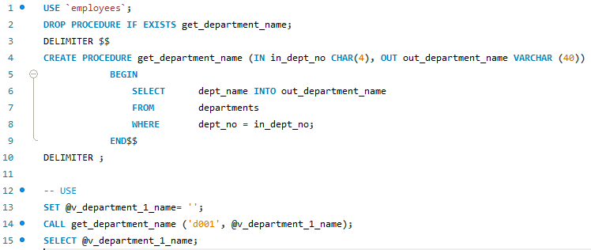
EXAMPLE 1
Notes:
DROP PROCEDURE IF EXISTS sp_getDepNameFromDepID;DELIMITER $$CREATE PROCEDURE sp_getDepNameFromDepID(IN dep_id TINYINT, OUT dep_name VARCHAR(50))BEGIN SELECT d.DepartmentName INTO dep_name FROM department d WHERE d.DepartmentID = dep_id;END$$DELIMITER ;SET @dep_Name ='';Call sp_getDepNameFromDepID(1,@dep_Name);SELECT @dep_Name;

Slide 7
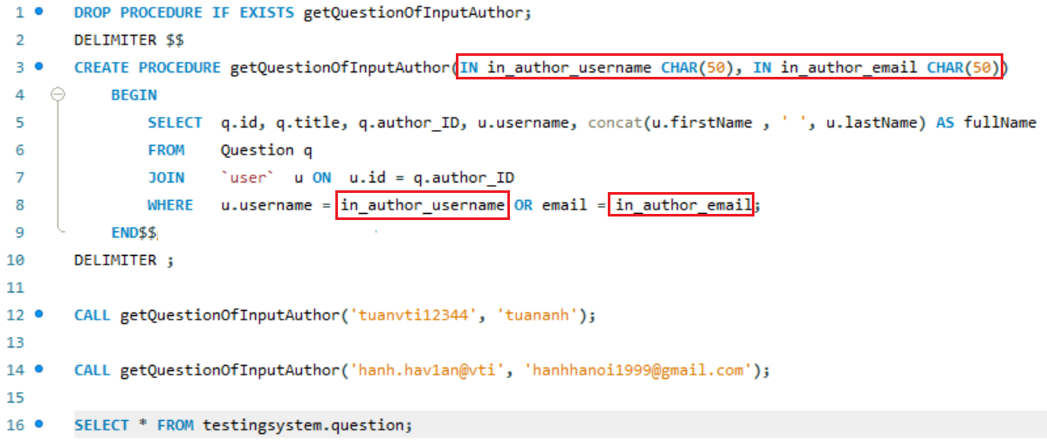
EXAMPLE 2

Slide 8
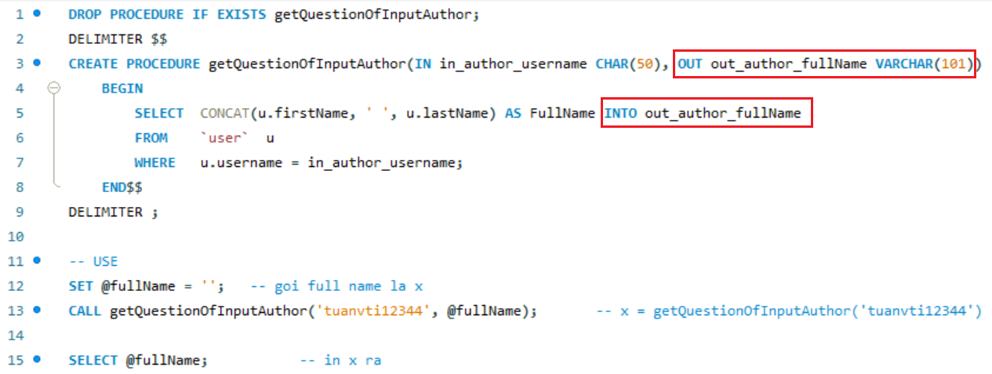
EXAMPLE 3

Slide 9
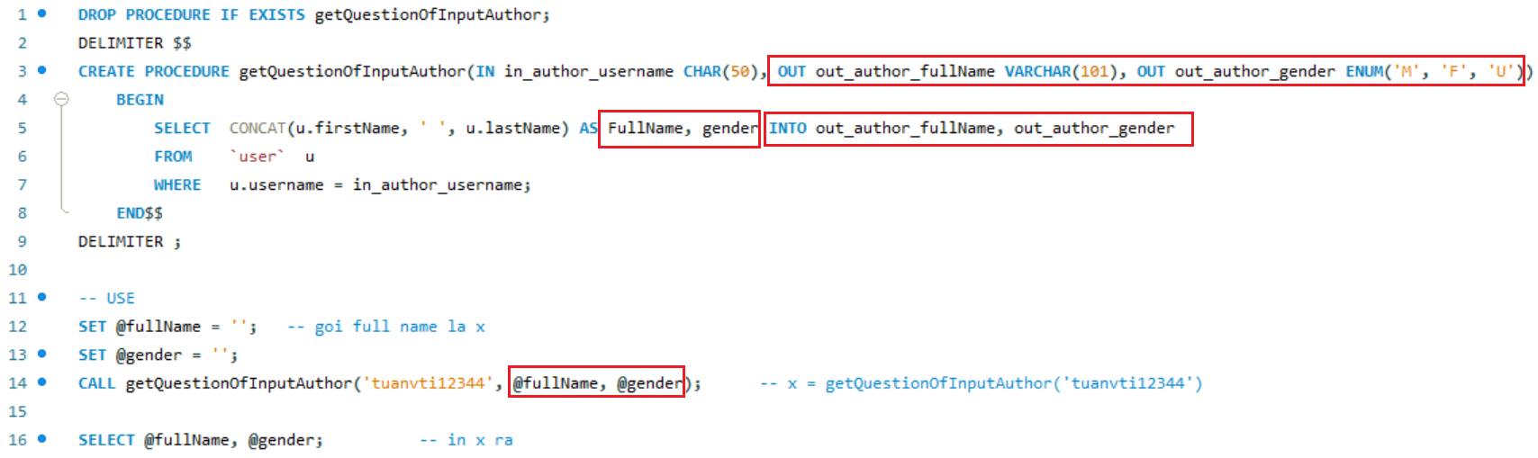
EXAMPLE 4

Slide 10
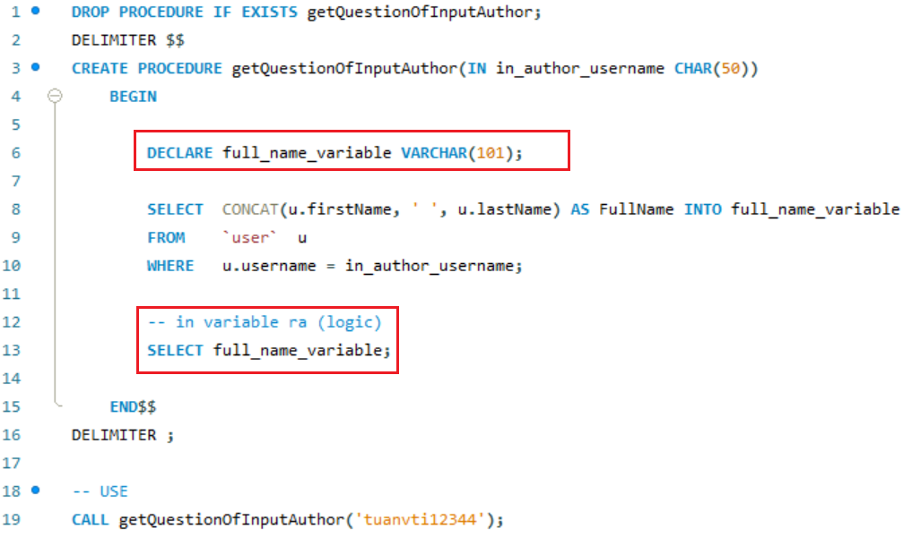
EXAMPLE 5

Slide 11
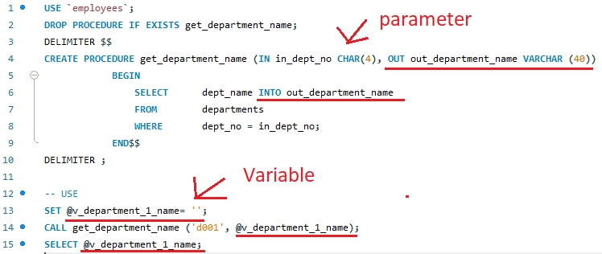
Assign value for parameter OUT

Slide 12
Function
User-defined function
Built-in functions

Slide 13
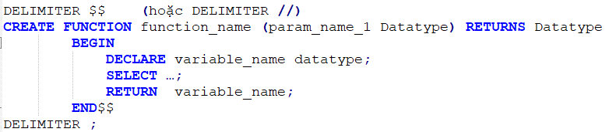
User-defined function
Create
Call
Drop

Slide 14
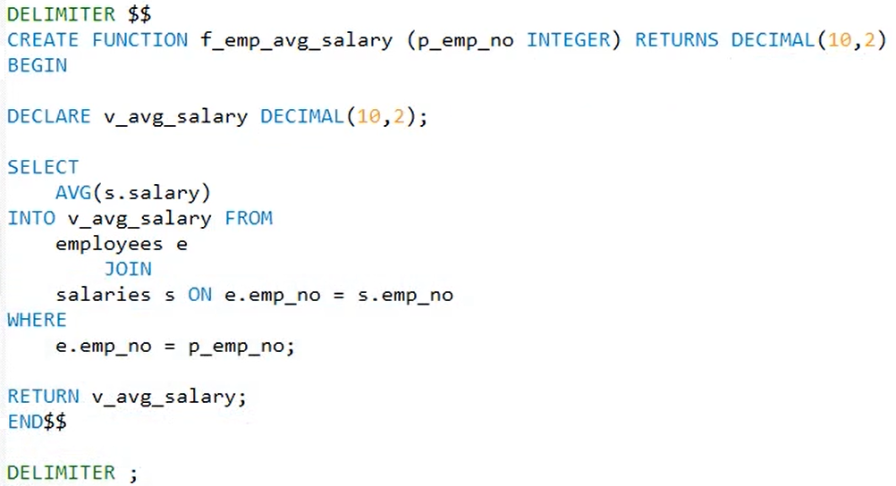
Example
SET GLOBAL log_bin_trust_function_creators = 1;

Slide 15
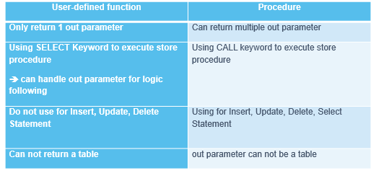
The Comparasion function and Stored Procedure

Slide 16
Built-in functions
Aggregate functions
Date time functions
Other
  Round
  String
  IFNULL() & COALESCE()

Slide 17
Aggregate functions
COUNT()
The difference of COUNT(column_name), COUNT(*), COUNT(1), COUNT(0)
  COUNT(column_name) count all values which is # null
  COUNT(*) count all rows of query which is satisfied condition
  COUNT(1) là count all value, which is 1 (similar COUNT(*))
  In addition, we can count distanct value (Using COUNT(DISTINCT column_name))
SUM()
MIN()
MAX()
AVG()
Note:
  Aggregate functions apply for value # null

Slide 18
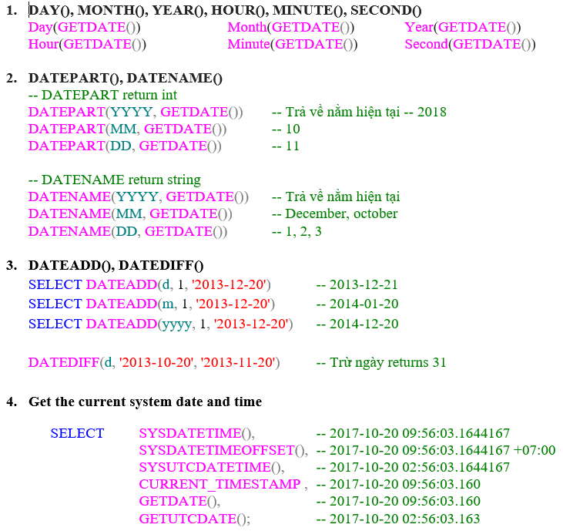
DateTime functions
https://www.w3schools.com/sql/func_mysql_date_add.asp

Slide 19
Optional JOIN
ON DELETE
ON UPDATE
Mode
  CASCADE
  NO ACTION
  SET NULL
  SET DEFAULT

Slide 20
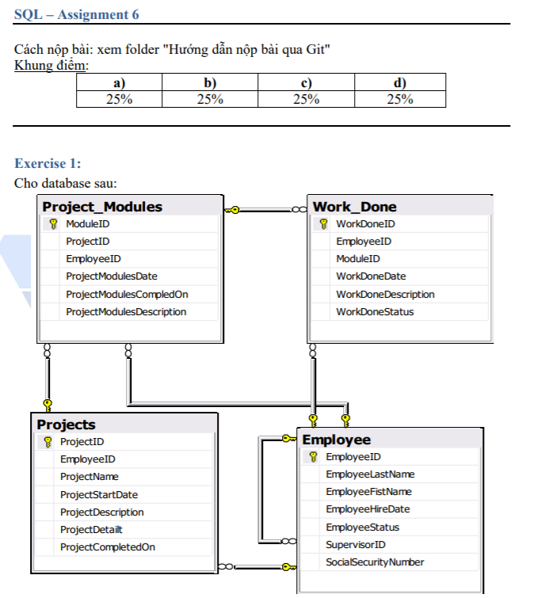
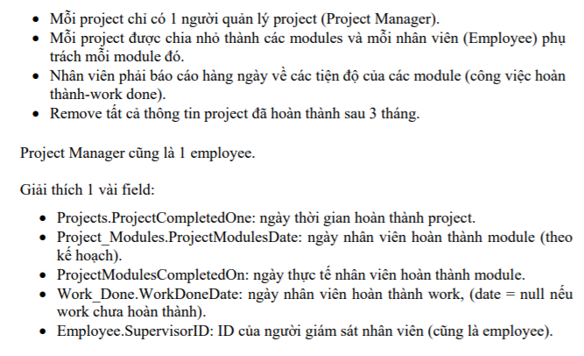
Assignments 1

Slide 21
Assignments 1

Slide 22
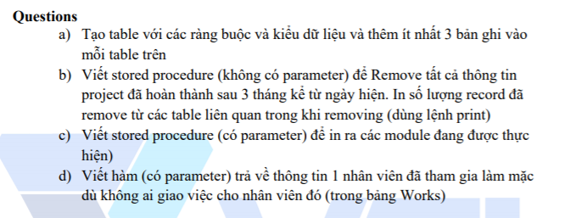
Assignments 1

Slide 23
Assignments 2
Assignments for Testing System

Slide 24
Q & A
Copyright © VTI Academy All Rights Reserved

